Slide 1

Prediction Of SmartPhone Addiction Using Ensemble Algorithm
by
YASWANTH RAO P
Roll No. 214G1A32C7
TAALIYA MUSKAN H
Roll No. 214G1A32B2
SAILATHA K
Roll No. 214G1A3295
VAMSI KRISHNA G
Roll No. 224G5A3214
Under the guidance of
Mr. A. Kiran Kumar _{M. Tech.,(Ph.D).}
Assistant Professor
Department of Computer Science and Engineering (Data Science)
Srinivasa Ramanujan Institute of Technology
(Affiliated to JNTUA & Approved by AICTE) (Accredited by NAAC with ‘A’ Grade & Accredited by NBA (EEE, ECE & CSE)
Rotarypuram Village, B K Samudram Mandal, Ananthapuramu – 515701.
2024 - 2025

Slide 2
Abstract
Smartphone addiction has become a global concern, significantly impacting people's daily lives, productivity, and mental health. With the increasing reliance on mobile devices, especially among students and professionals, understanding and predicting smartphone addiction has become crucial. It evaluates models like Support Vector Classifier (SVC) and Naive Bayes (NB) alongside advanced algorithms such as AdaBoost,XGBoost, Decision Trees. The binary classification categorizes individuals as "Addicted" or "Not Addicted," focusing on behaviors like phone use in social settings and habitual checking. This research has significant implications for developing interventions to curb smartphone addiction, providing actionable insights for policymakers, educators, and mental health professionals. It could also be used by app developers to design apps that are less addictive and promote healthier phone use habits.

Slide 3

Contents
Abstract
Problem Statement
Objectives of Project
Literature survey
Proposed Work
Introduction
Existing System

Slide 4
Cond..,
Proposed System
Planning
Requirements
Data Preprocessing Techniques
Data Flow Diagram
References
GitHub Link
Queries

Slide 5

Problem Statement
Smartphone addiction, though increasingly recognized, is not always easily diagnosed or predicted. Many existing models either fail to capture the full scope of behaviors leading to addiction or lack the accuracy needed to provide reliable predictions.
As mobile technology continues to become an integral part of everyday life, there is an urgent need for a robust, data-driven approach to identifying potential smartphone addiction cases.
The absence of reliable prediction models limits our ability to intervene early and address the addiction before it worsens. Thus, the central problem this research aims to solve is the accurate prediction of smartphone addiction using machine learning techniques.

Slide 6
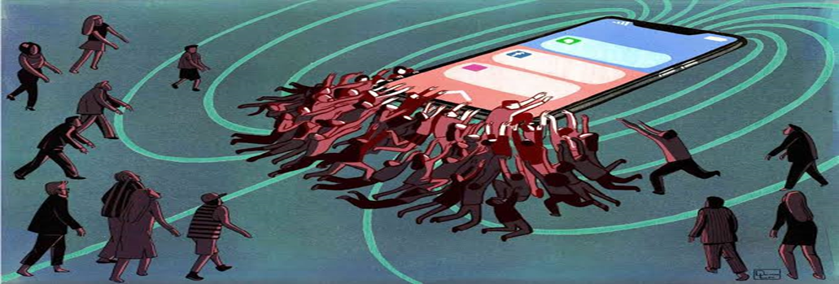
Objective
The main goal of this research is to develop a machine learning model that accurately predicts smartphone addiction by analyzing a range of behavioral and demographic factors. The specific objectives of the study are:
Identifying key factors that influence smartphone addiction and evaluate the effectiveness of various machine learning algorithms, including Support Vector Classifier (SVC), Naive Bayes (NB), AdaBoost, XGBoost, Decision Trees.
Comparing the accuracy of traditional algorithms with newer ensemble techniques.

Slide 7
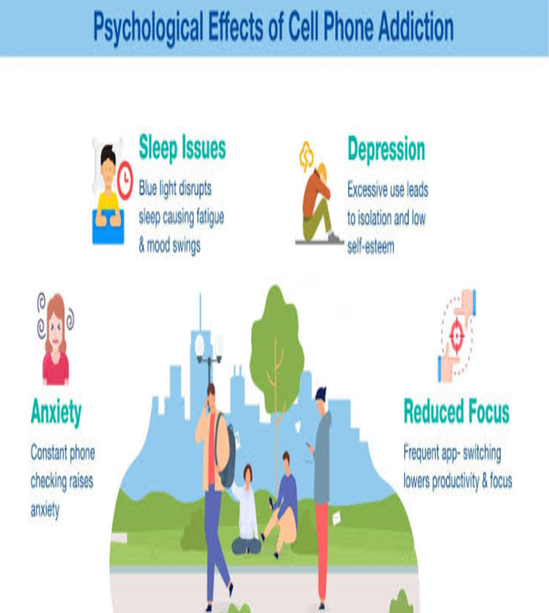
Cond..,
Providing actionable insights for stakeholders, such as educators and mental health professionals, to aid in intervention strategies.
To emphasize the importance of this research in addressing the increasing issue of smartphone addiction. By enabling early detection through predictive models, timely interventions can be implemented to reduce the negative effects on mental health, productivity, and social relationships.

Slide 8
Literature Survey
No | Title | Author | Journal Name & Year | Methodology Adapted | Key Findings | Gaps
1. | Relationships among smartphone addiction, stress satisfaction with life | Samaha & Hawi | Computers in Human Behavior & 2016 | Machine learning Techniques like Linear Regression and accuracy 53% | The study found that smartphone addiction can have negative effects on mental health and well-being. | Limited sample size.
2 | Severity Detection of Problematic Smartphone Usage (PSU) and its Effect on Human Lifestyle. | Fairuz Tanzim Achal∗, Mosammat Suraiya | 2023 IEEE 8th (I2CT) Pune, India & 2023 | Machine Learning Techniques like SVM, Random forest and accuracy 83% | PSU severity is associated with negative effects on mental health. | Lack of standardized measures.
3 | The relationship between smartphone usage duration | Rodney Pope | BMC Musculoskelet Disord & 2021 | Machine learning Techniques like Decision Tree, Regression Algorithm and Accuracy 72% | This project's goal was to Young people in particular are increasingly using smartphones for activities. | Insufficient exploration of demographic differences.

Slide 9
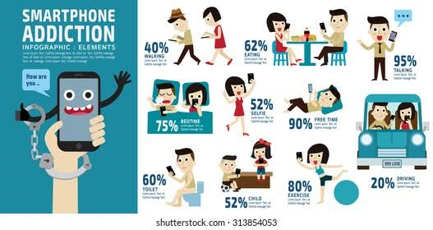
Proposed Work
The proposed work involves a systematic methodology to develop a predictive model for smartphone addiction using machine learning. The key steps include:
Data Collection
Data Preprocessing
Feature Selection and Engineering
Model Development
Model Evaluation
Deployment and Visualization

Slide 10
Introduction
In recent years, the pervasive use of smartphones has become an integral part of modern life, revolutionizing communication, information access, and entertainment. However, excessive smartphone usage has led to concerns about smartphone addiction, a behavioral issue that adversely affects mental health, social interactions, and productivity. Smartphone addiction is characterized by compulsive usage patterns, withdrawal symptoms when the device is inaccessible, and interference with daily life activities. The prediction of smartphone addiction using machine learning (ML) techniques provides a promising approach to identifying individuals at risk and enabling timely interventions.
Machine learning can analyze complex patterns in user data, such as usage frequency, duration, application categories, and contextual factors, to assess addiction levels. This project aims to design and implement a machine-learning-based system to predict smartphone addiction, utilizing datasets that capture behavioral and demographic information.

Slide 11
Existing Method
In the existing system, implementation of machine learning algorithms is bit complex to build
Due to the lack of information about the data visualization. Mathematical calculations are used
In existing system for Logistic Regression model building this may takes the lot of time and
Complexity. To overcome all this, we use machine learning packages available in the
Scikit-learn library.
Disadvantages:
1. Requires more time
2. Difficult to handle

Slide 12
Proposed System
The proposed system enhances the prediction of smartphone addiction by incorporating advanced ensemble techniques and decision tree-based models, including AdaBoost, XGBoost, and Decision Trees. These models are designed to improve accuracy by combining the strengths of multiple classifiers.
AdaBoost: A boosting algorithm that combines weak learners to form a strong classifier, iteratively improving model performance.
XGBoost: An optimized gradient boosting algorithm that is known for its speed and performance, especially in handling large datasets with high complexity.
Decision Trees: A model that splits data into branches to make decisions based on feature values. This is particularly useful for interpreting the importance of different behavioral factors in addiction.

Slide 13
Proposed System
Naïve Bayes: It is a classification algorithm based on Bayes’ Theorem, which operates under the assumption that the features are conditionally independent, given the class. It is highly effective for classification tasks, particularly when working with large datasets.
The proposed system aims to improve the prediction of smartphone addiction by leveraging these advanced models' ability to handle complex relationships and imbalanced datasets. By employing ensemble methods, the system also aims to enhance generalization and reduce the variance that can occur in traditional models.

Slide 14
Planning
Timeline
Phase 1: Planning
Phase 2: Data Preparation
Phase 3: Model Development
Phase 4: Model Evaluation
Phase 5: Deployment
Phase 6: Testing
Resource Requirements
Tools
Hardware
Datasets
Risk Management
Data Issues
Deployment Challenge

Slide 15
Data Description
The dataset used in this study consists of responses from individuals, focusing on their smartphone usage habits and related behaviors. It contains features, most of which are categorical, representing different aspects of phone usage that could contribute to smartphone addiction. Key variables include:
Dependency Indicators: Questions like “Do you worry about losing your phone?” and “Do you have a panic attack if you leave your phone elsewhere?” reflect anxiety and dependency on mobile devices.
Addiction Label: A binary outcome where participants are labelled as either "Addicted" or "Not Addicted," based on their responses.
Phone Usage Behaviours: These are questions related to specific actions like taking phones to the bathroom, using phones in social settings, or checking phones before sleeping.

Slide 16
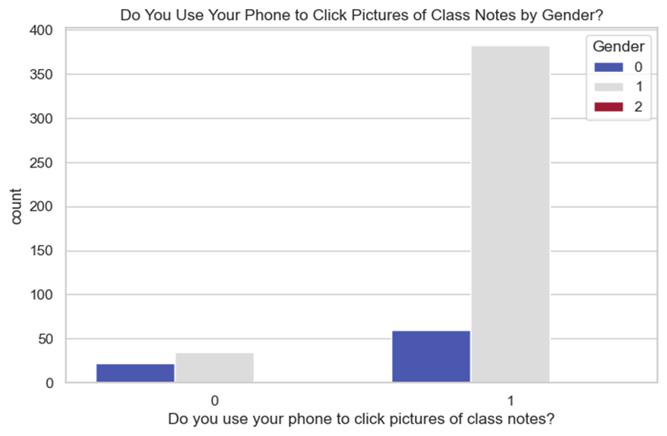
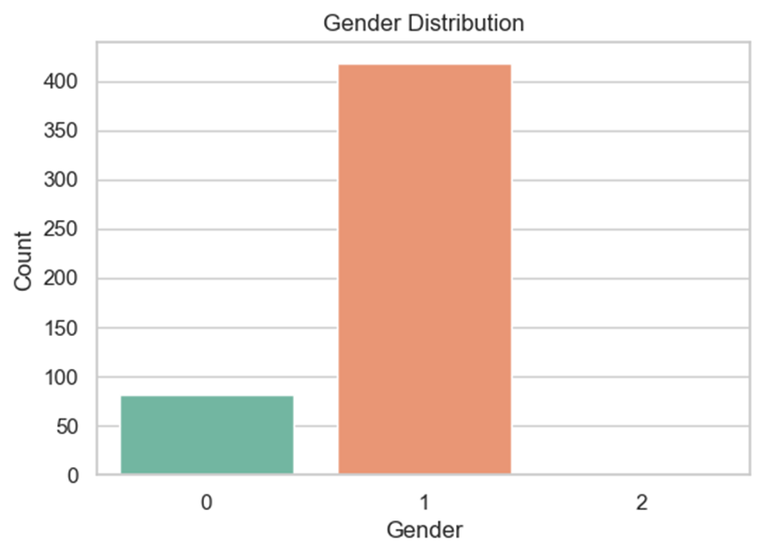
Cond..,
Gender: Demographic information about the participants.
The dataset, though containing some missing values, provides a comprehensive overview of behaviors indicative of smartphone addiction. Cleaning and pre-processing steps such as handling missing data and encoding categorical variables are necessary for preparing the dataset for machine learning models.
EDA Explanation:
Gender Distribution
Phone usage pattern by gender

Slide 17
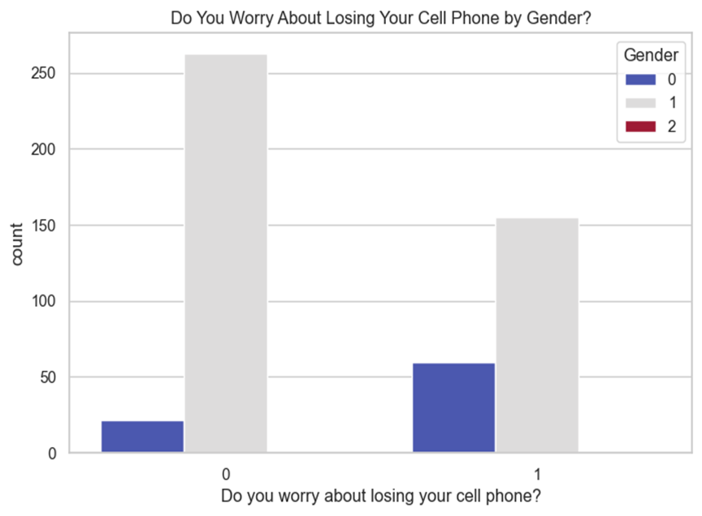
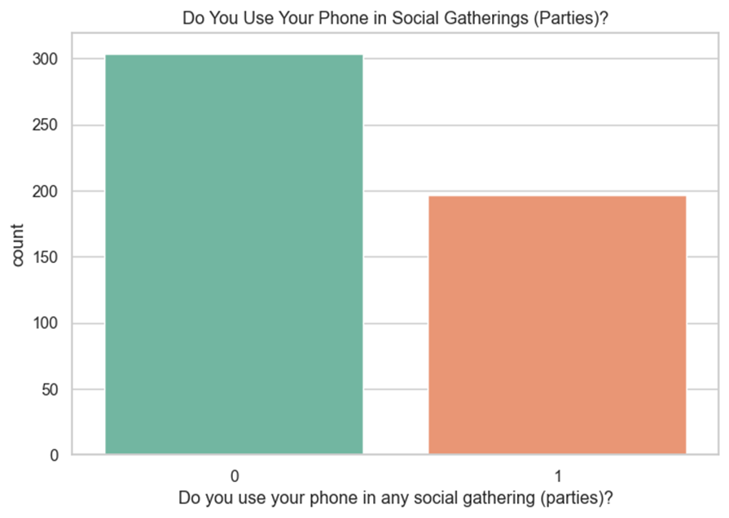
Cond..,
Worry about Losing Phone by Gender
Distribution of Phone Use in Social Gatherings

Slide 18
Requriments
S/W CONFIGURATION:
Operating System : Windows 7/8/10
Server side Script : HTML, CSS
Programming Language : Python
Libraries :Pandas, MySQL. Connector, Tensor flow
IDE/Workbench : VS Code
Technology : Python 3.8+

Slide 19
Cond..,
H/W CONFIGURATION:
Processor - I3/Intel Processor
Hard Disk - 160GB
Key Board - Standard Windows Keyboard
Mouse - Two or Three Button Mouse
RAM - 8GB

Slide 20
Functional Requirements
Data Collection
Data Analysis
Predicting Model
Gamification
Integration with Other Apps
Alert System

Slide 21
Non-Functional Requirements
Security
Scalability
Performance

Slide 22
UML DIAGRAMS
In smartphone addiction prediction, UML (Unified Modeling Language) can be used to create models that represent the behavior and interactions of smartphone users. Here are some ways UML can be applied to smartphone addiction prediction:
Use case diagram:
A use case diagram in the unified modeling language (uml) is a type of behavioral; diagram defined by and created from a use-case analysis. Its purpose is to present a graphical overview of the functionality provided by a system in terms of actors, their goals (represented as use cases), and any dependencies between those use cases. The main purpose of a use case diagram is to show what system functions are performed for which actor. Roles of the actors in the system can be depicted.

Slide 23
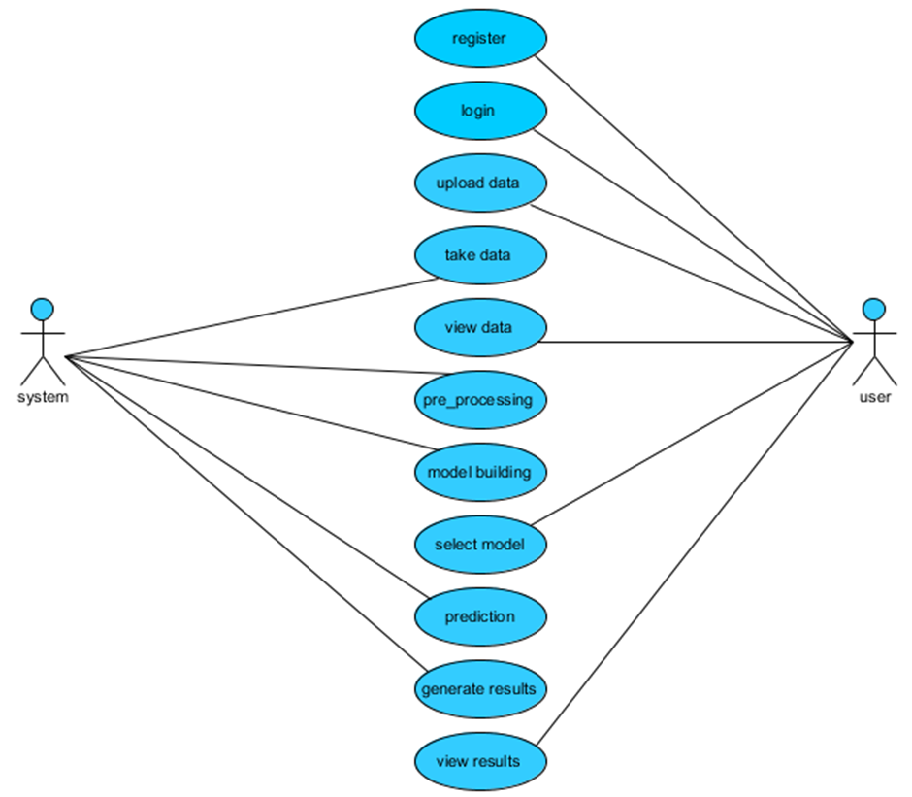
Cond..,
Class diagram:
In software engineering, a class diagram in the unified modeling language (uml) is a type of static structure diagram that describes the structure of a system by showing the system's classes, their attributes, operations (or methods), and the relationships among the classes. It explains which class contains information.

Slide 24
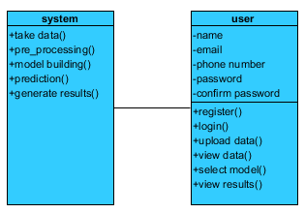
Cond..,
Sequence diagram:
A sequence diagram in unified modeling language (uml) is a kind of interaction diagram that shows how processes operate with one another and in what order. It is a construct of a message sequence chart. Sequence diagrams are sometimes called event diagrams, event scenarios, and timing diagrams.
Sequence diagrams can be used to model the sequence of events that occur when a smartphone user interacts with their device, such as the order in which they use different apps or the frequency of notifications. This can help identify patterns of behavior that may be indicative of addiction.

Slide 25
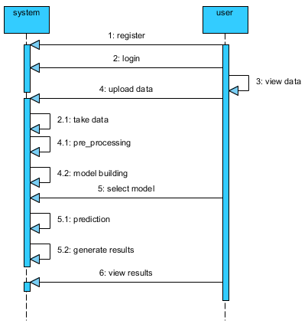
Cond..,
Collaboration diagram:
In collaboration diagram the method call sequence is indicated by some numbering technique as shown below. The number indicates how the methods are called one after another. We have taken the same order management system to describe the collaboration diagram. The method calls are similar to that of a sequence diagram. But the difference is that the sequence diagram does not describe the object organization whereas the collaboration diagram shows the object organization.

Slide 26
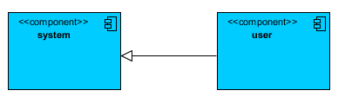
Cond..,
Activity diagram:
Activity diagrams are graphical representations of workflows of stepwise activities and actions with support for choice, iteration and concurrency. In the unified modeling language, activity diagrams can be used to describe the business and operational step-by-step workflows of components in a system. An activity diagram shows the overall flow of control.
Activity Diagram: "Smartphone User Activities“ - Activities: gaming, social media, productivity.

Slide 27
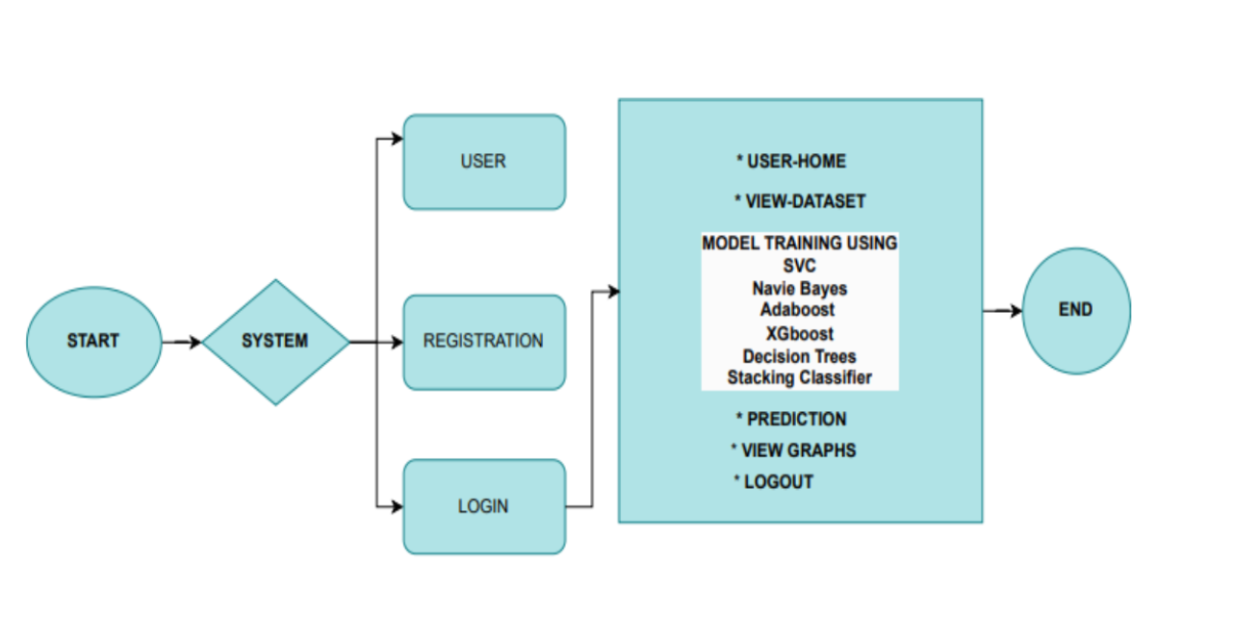
FlowChart

Slide 28
Data Preprocessing Techinques
Once the data is collected, it will go through several preprocessing steps to ensure it is clean, consistent, and suitable for training machine learning models. These steps include:
Handling Missing Data: Impute missing values using appropriate strategies (e.g., mean imputation for numerical data, mode for categorical data).
Feature Scaling: Normalize or standardize numerical features (e.g., screen time, frequency of unlocks) to ensure uniformity in the range and prevent certain features from dominating others.
Encoding Categorical Variables: Convert categorical data (e.g., gender, app type) into numerical format using one-hot encoding or label encoding.
Feature Engineering: Generate new features that may be relevant to addiction prediction, such as daily screen time averages, time-of-day patterns, and app category classifications.

Slide 29
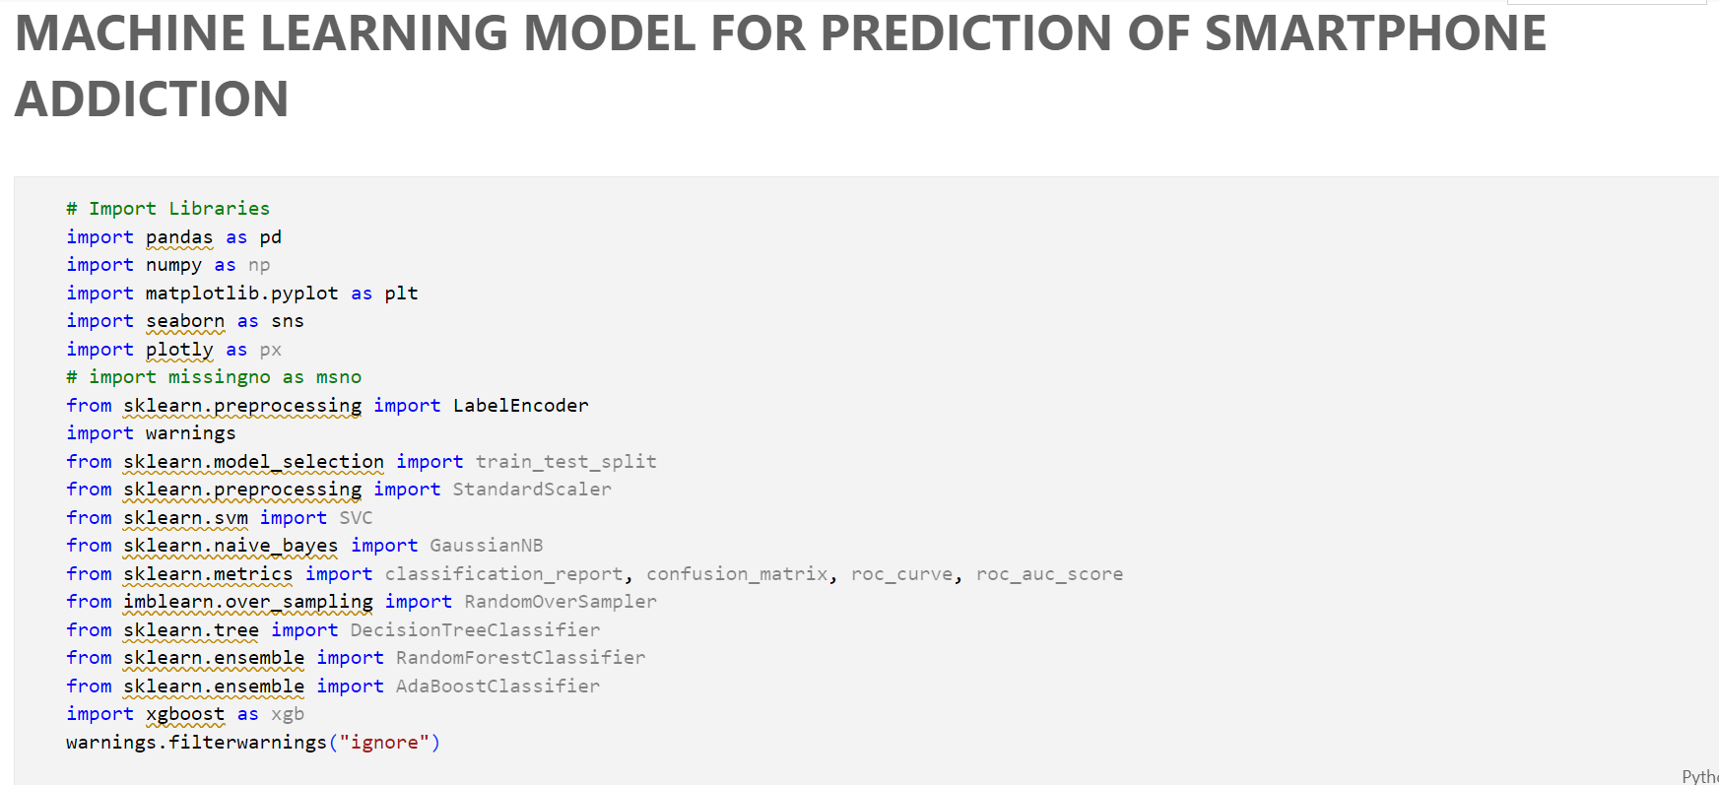
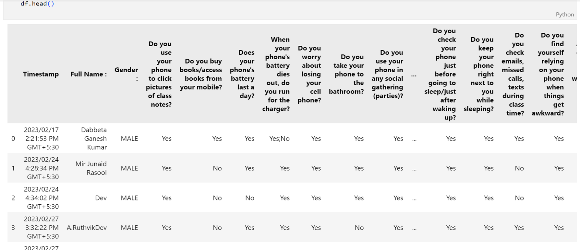
Sample code

Slide 30
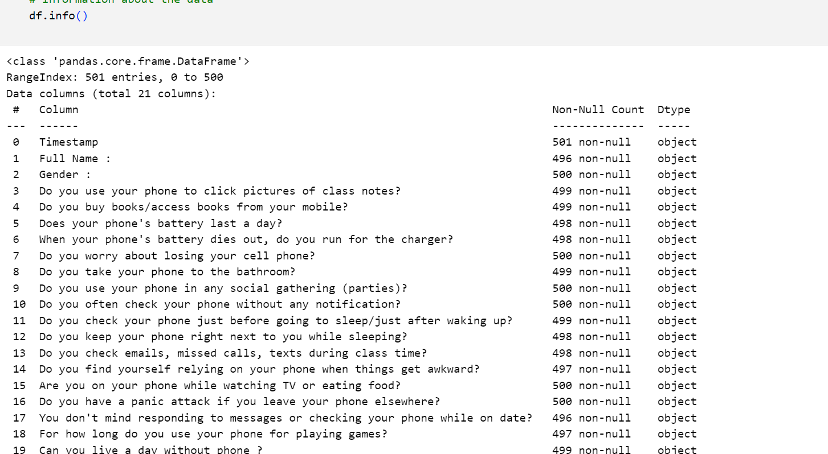
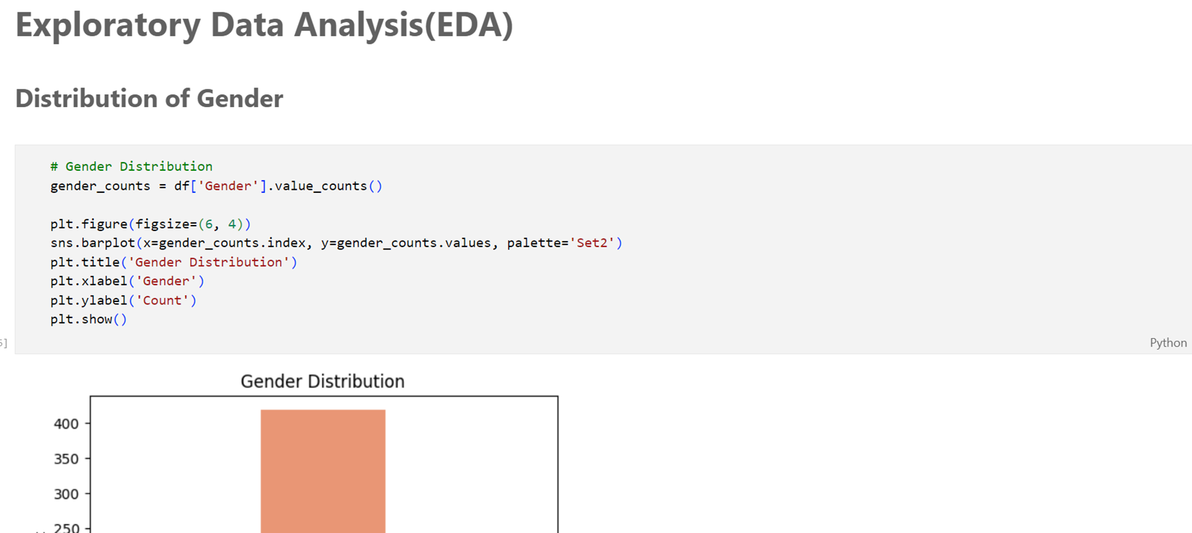
Cond..,

Slide 31
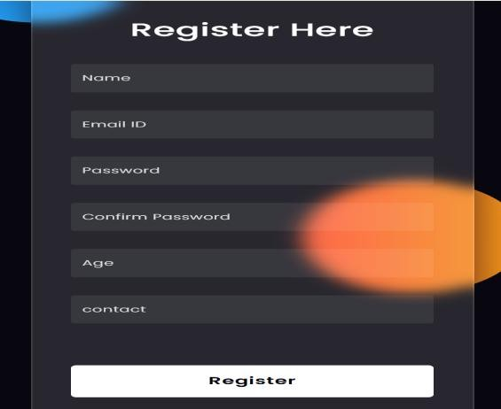
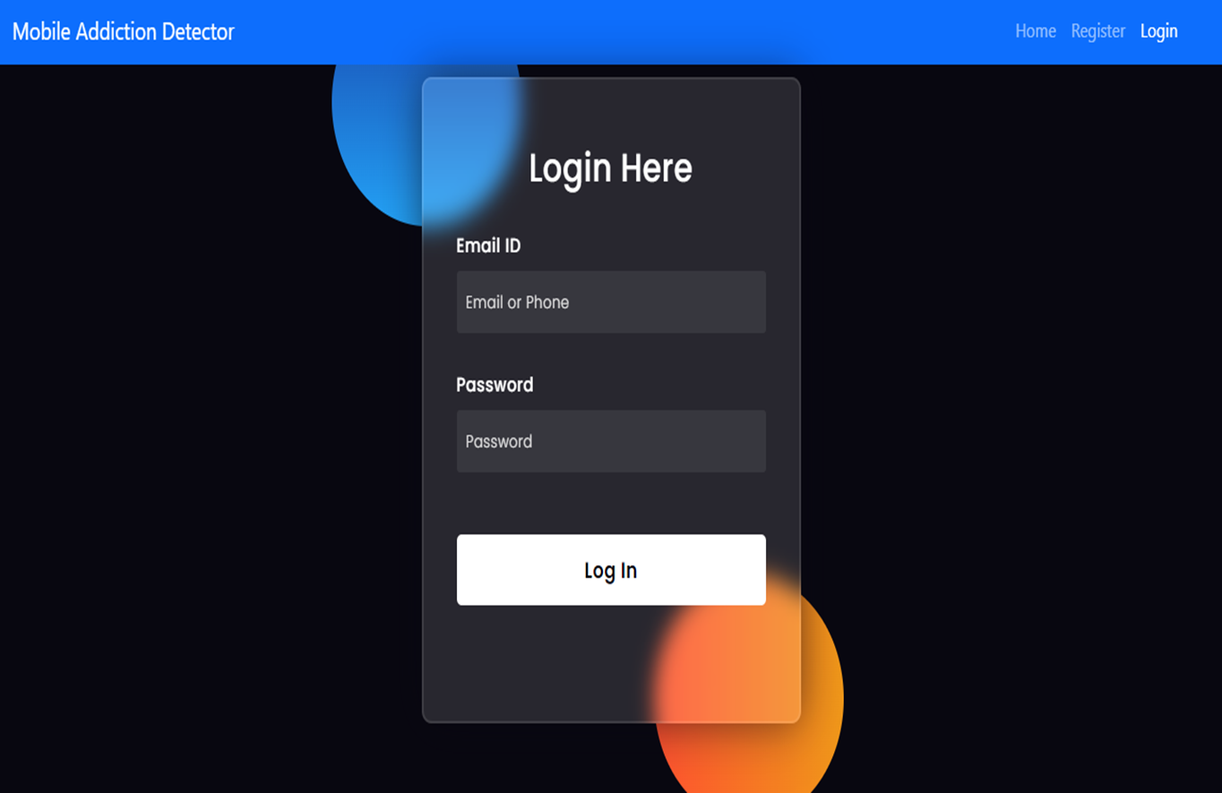
Output ScreenShots

Slide 32
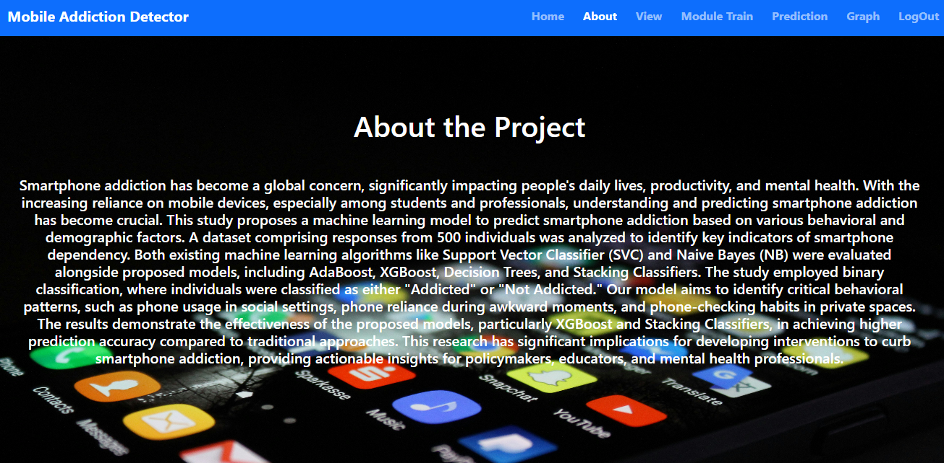
Cond..,

Slide 33
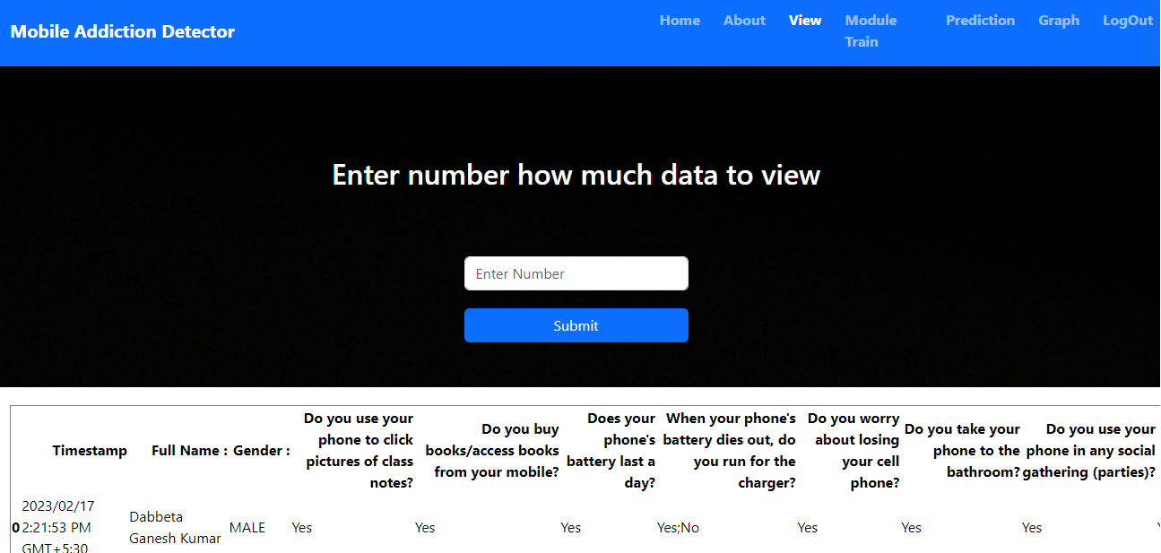
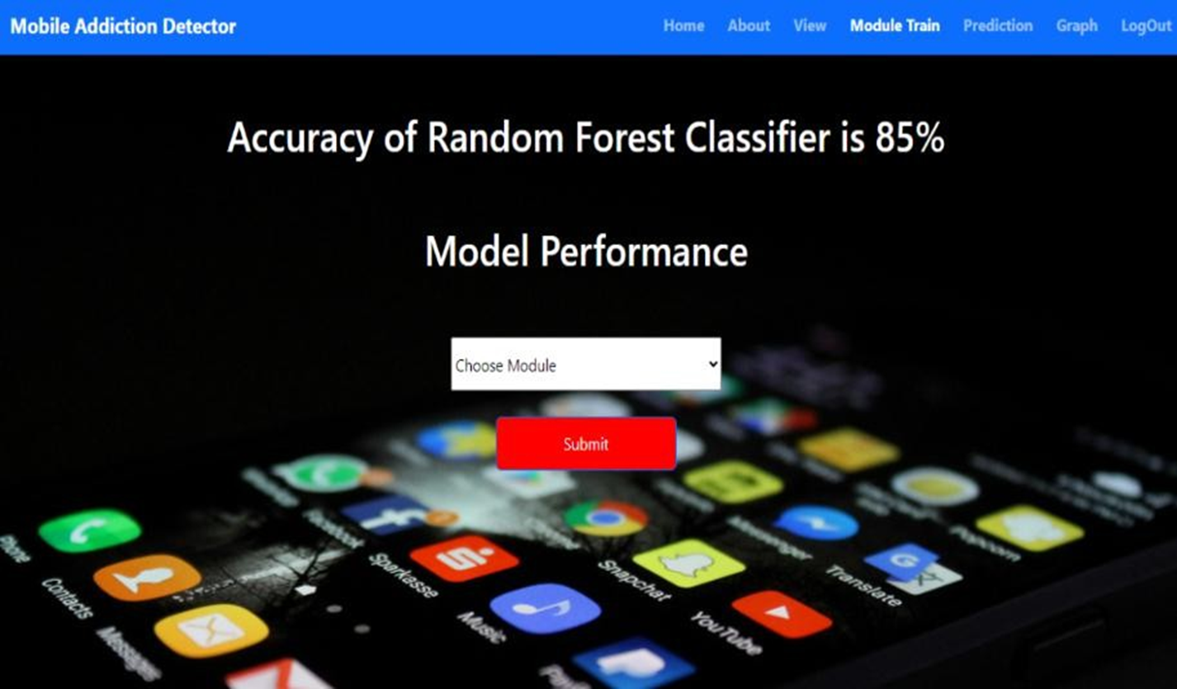
Cond..,

Slide 34
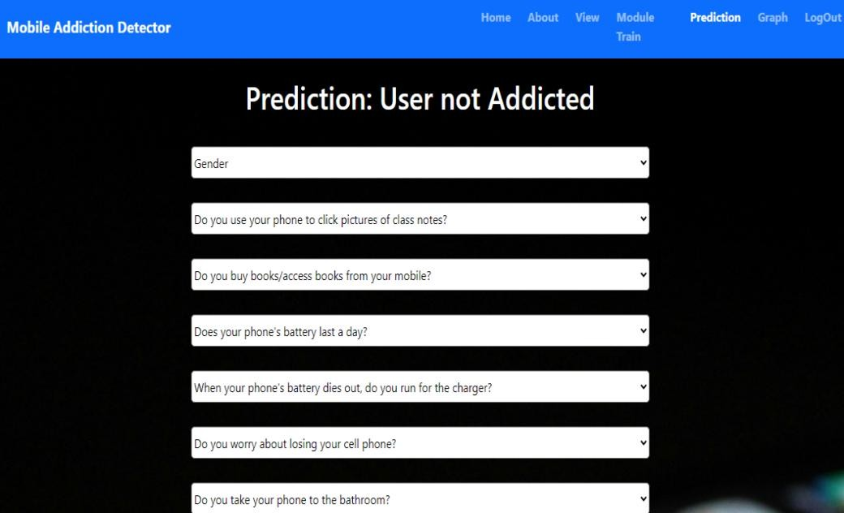
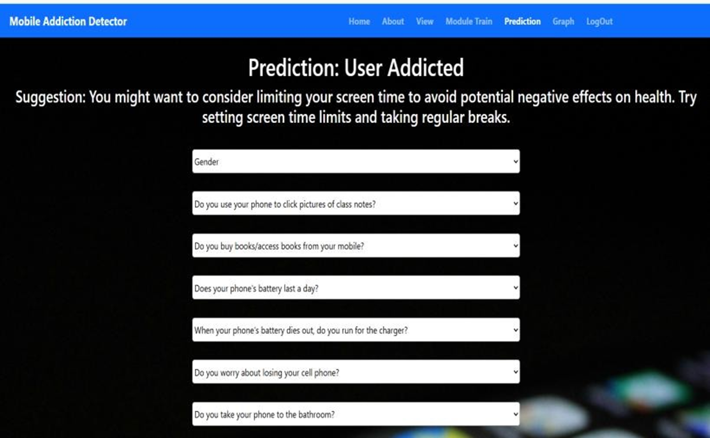
Cond..,

Slide 35
Conclusion
This research developed a machine learning model to predict smartphone addiction using various behavioral and demographic factors. The analysis revealed that certain phone usage behaviors, such as checking the phone before sleep, using it during social events, and feeling panic when separated from it, are strongly linked to addiction. The ensemble models implemented, including AdaBoost, XGBoost, Stacking Classifiers, and Decision Trees, demonstrated superior performance in accuracy and precision compared to traditional models like SVC and Naive Bayes. These results suggest that advanced machine learning techniques can enhance the prediction of smartphone addiction by uncovering complex patterns in user behavior.

Slide 36
Reference
[1] Elhai, J.D., Dvorak, R.D., Levine, J.C., & Hall, B.J. (2017). Problematic smartphone use: A conceptual overview and systematic review of relations with anxiety and depression psychopathology. Journal of Affective Disorders,207, 251-259.
[2] Lin, Y.H., Lin, Y.C., Lee, Y.H., Lin, P.H., Lin, S.H., & Chang, L.R. (2016). Time distortion associated with smartphone addiction: Identifying smartphone addiction via a mobile app. Journal of Psychiatric Research, 77, 6-10.
[3] Lee, H., Ahn, H., Choi, S., & Choi, W. (2019). The SAMS: Smartphone Addiction Management System and verification. Journal of Medical Internet Research,
21(6), e12853.
[4] Bianchi, A., & Phillips, J.G. (2015). Psychological predictors of problem mobile phone use. CyberPsychology &Behavior, 8(1), 39-51.

Slide 37
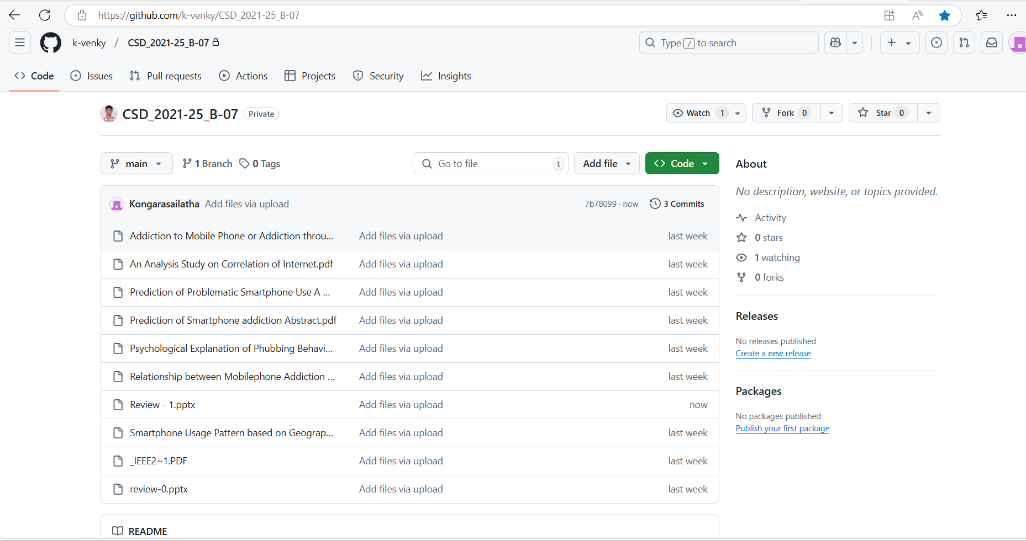

Git Hub Dashboards
CSD 2021– 25_B-07

Slide 38
Any Queries?

Slide 39
Thank You!!!

